Slide 1


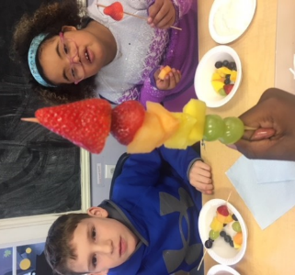
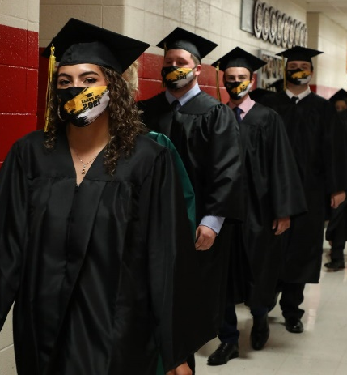
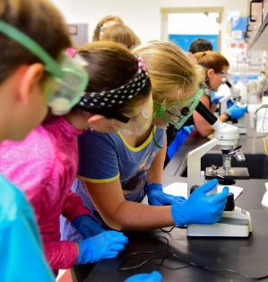

Delaware
Summer Food Service Program
Notes:
This presentation is designed to help you learn about the Summer Food Service Program. This program is regulated and funded by the United States Department of Agriculture and is administered in locally by the Delaware Department of Education. This program is intended to provide children 18 years of age and under with nutritious meals and snacks in the summer months when school is not in session.
Meal service is organized by a variety of sponsors, including schools and nonprofit organizations. Sites are the location where meals are served, and can be schools, parks, community centers and more.
During this presentation we provide an overview, review meal trends, discuss new site models, and share how families can access meals.

Slide 2

Overview
Sponsors
Number of Approved Sites
Total Sponsors for Delaware in 2024: 29 Sponsors
Total number of sites for Delaware in 2024: 356 Approved Sites
 | Kent County | New Castle County | Sussex County
2022 | 6 | 16 | 8
2023 | 7 | 16 | 8
2024 | 5 | 16 | 8
 | Kent County | New Castle County | Sussex County
2022 | 65 | 180 | 84
2023 | 63 | 177 | 79
2024 | 66 | 118 | 172*
Notes:
Here’s an overview of the sponsors and the number of approved sites over the past three years. In 2024, the state had a total of 29 sponsors. There were five sponsors in Kent County, 16 in New Castle County, and eight in Sussex County. We had a total of 356 approved sites in the state. Sixty-six were in Kent County, 118 were in New Castle County, and 172 were in Sussex County.
*In 2024, Sussex County’s sites more than doubled compared to 2023. This significant increase was primarily due to the addition of rural non-congregate sites and the required designation of each stop on a mobile route as a separate site.

Slide 3
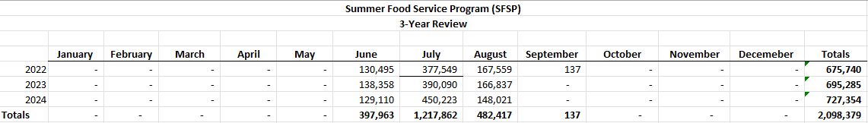
SFSP Meals
Three Year Review
Notes:
Here we have the SFSP Meals 3-Year Review.
SFSP Three-Year Review chart shows meal counts from 2022 to 2024. The meal counts are a combined total of breakfast, lunch, snack, and supper meals.
Key trends:
Overall Growth: Meal counts have increased each year, rising from 675,345 in 2022 to 695,285 in 2023, and further to 727,354 in 2024. This indicates a steady growth of the program.
Peak Months: The highest meal counts consistently occur in July.
Largest Annual Increase: The most significant jump occurred between 2023 and 2024, with an increase of 32,069 meals, which is either due to higher demand or expanded service reach.
Total Three-Year Impact: Over the last three years, the program has provided 2,098,379 meals, highlighting its importance in addressing food insecurity for children during the summer months.
This data shows the program’s increasing reach and continued need for supporting children during school breaks.

Slide 4
Meal Sites
Schools
Community Centers
Summer Camps
Housing Developments
Libraries
Religious Centers
Mobile Sites
Notes:
Here are some of the types of sites where SFSP meals are provided in Delaware:
Schools;
Community centers;
Summer camps;
Housing developments;
Libraries;
Religious centers; and
Mobile/food truck sites.

Slide 5
New: Rural Non-Congregate
What It Is:
The Summer Food Service Program (SFSP) Rural Non-Congregate option provides free, nutritious meals to children in rural areas where traditional, in-person meal service is not feasible.
How It Works:
Designed for areas without access to congregate meal sites (e.g., schools, community centers).
Meals can be picked up, delivered, or provided through meal bundles for multiple days.
Helps ensure children in rural communities receive proper nutrition even when gathering at a central location is not possible.
Why It Matters:
Expands meal access to low-income children who might otherwise go without.
Provides flexibility for families in areas with transportation barriers.
Supports food security and promotes children’s health and well-being during summer months.
Notes:
SFSP Rural Non-Congregate
What It Is:
The Summer Food Service Program (SFSP) Rural Non-Congregate option provides free, nutritious meals to children in rural areas where traditional, in-person meal service is not feasible.
How It Works:
Designed for areas without access to congregate meal sites (e.g., schools, community centers).
Meals can be picked up, delivered, or provided through meal bundles for multiple days.
Helps ensure children in rural communities receive proper nutrition even when gathering at a central location is not possible.
Why It Matters:
Expands meal access to low-income children who might otherwise go without.
Provides flexibility for families in areas with transportation barriers.
Supports food security and promotes children’s health and well-being during summer months.

Slide 6
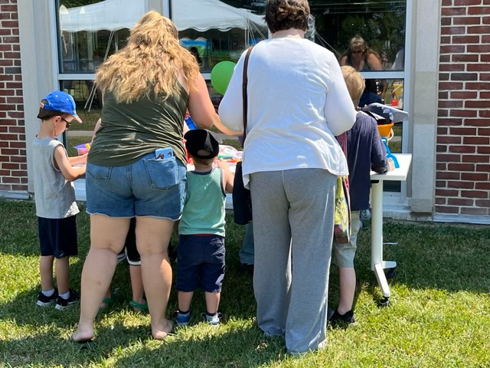
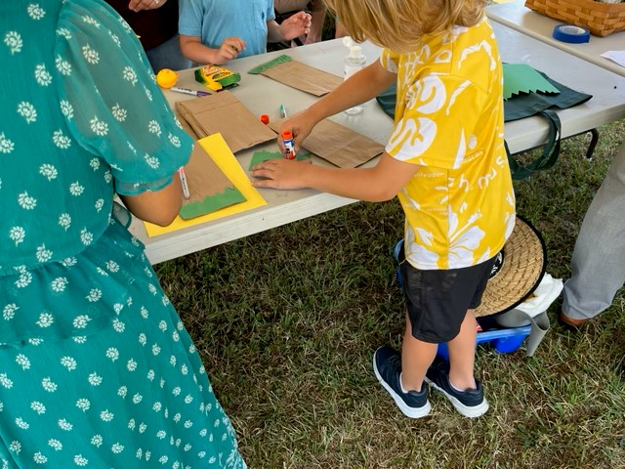
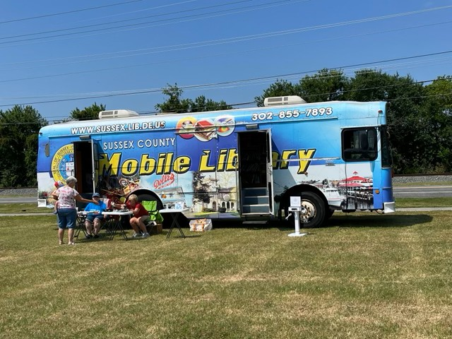
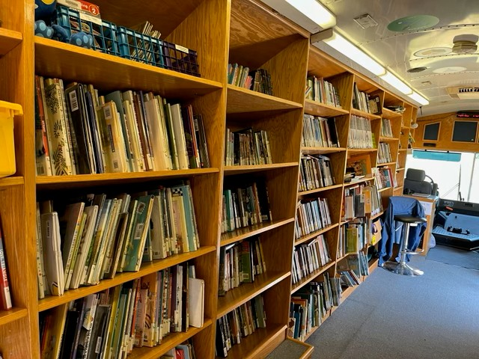
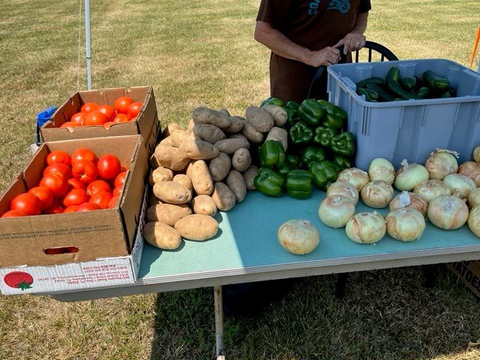
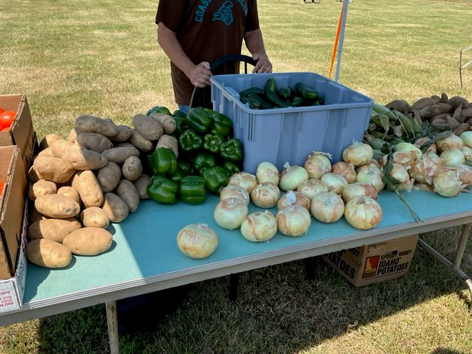
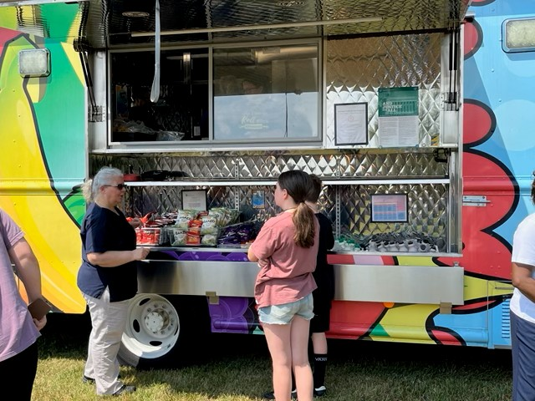
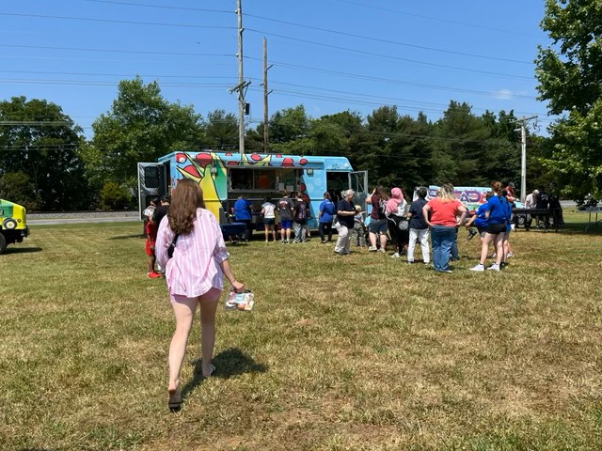
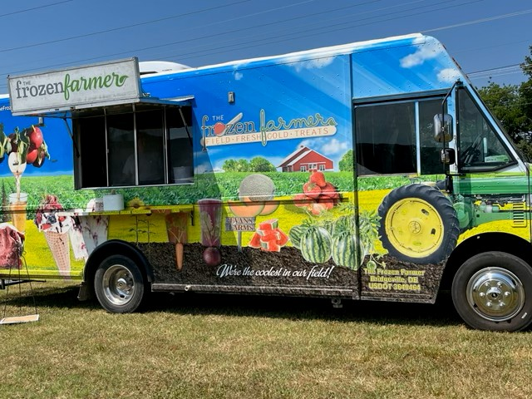
2024 Summer Highlights
Notes:
We asked sponsors to share some highlights from the 2024 Summer Food Service Program.
The Seaford School District SFSP Kickoff Event showcased the impact of SFSP.
Top Row: Families and children participated in activities, including a visit from the Mobile Literacy Bus, which travels the county providing books for children to check out.
Middle Row: Inside the bus, children could explore, open a library card, and check out books, while families received fresh fruits and vegetables from the produce stand.
Bottom Row: Julie Kirby, Seaford School District’s, Supervisor of Nutrition Services spoke to children about meals offered, followed by lunch distributed from the food truck. The event also offered a refreshing treat from the Frozen Farmers Food Truck.
This event highlighted the program’s commitment to nutrition, literacy, and community engagement.

Slide 7
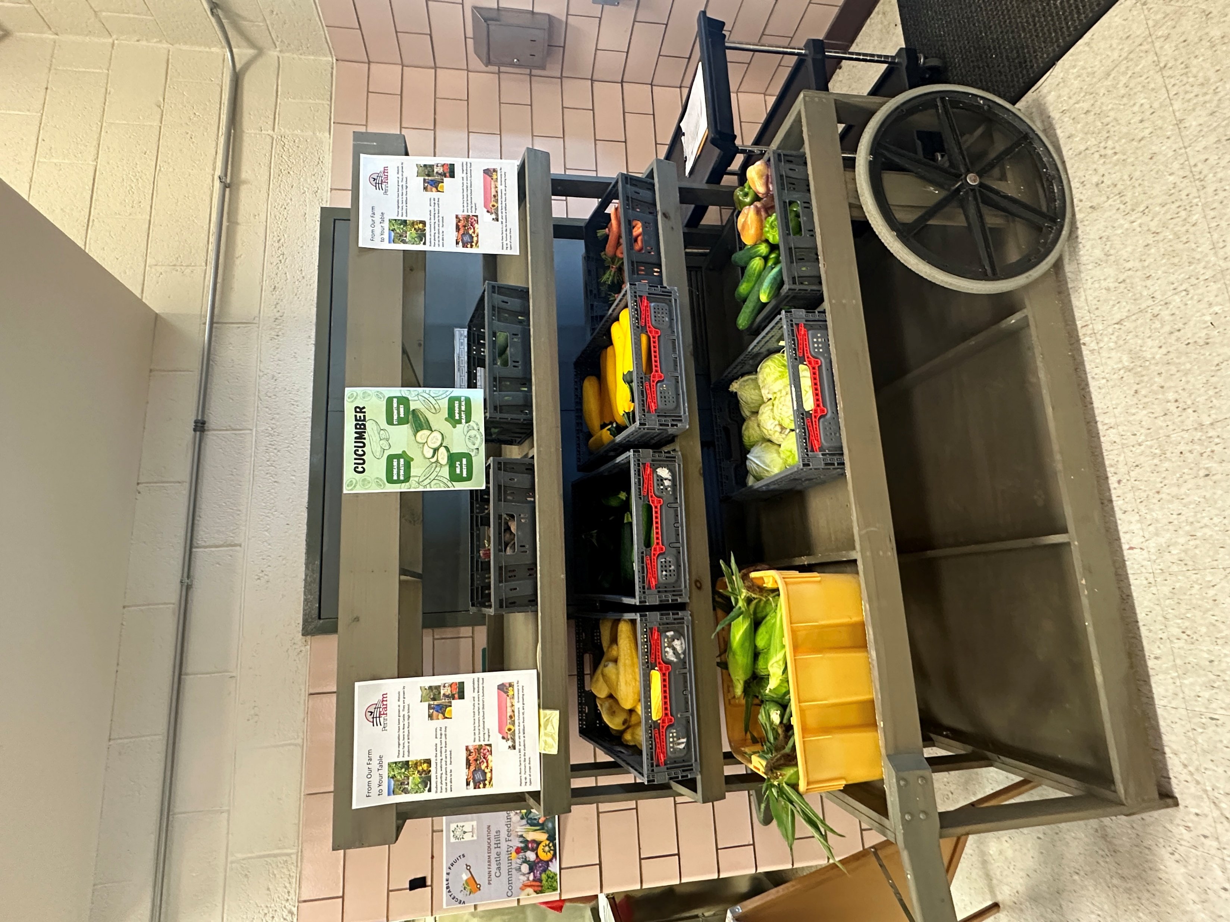
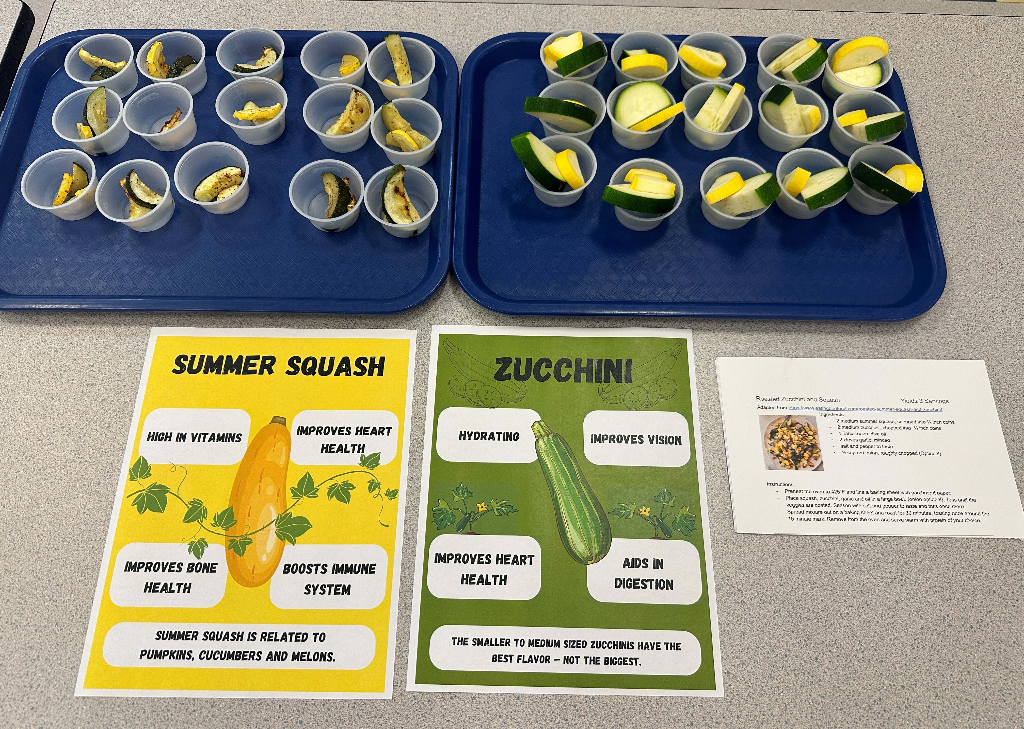
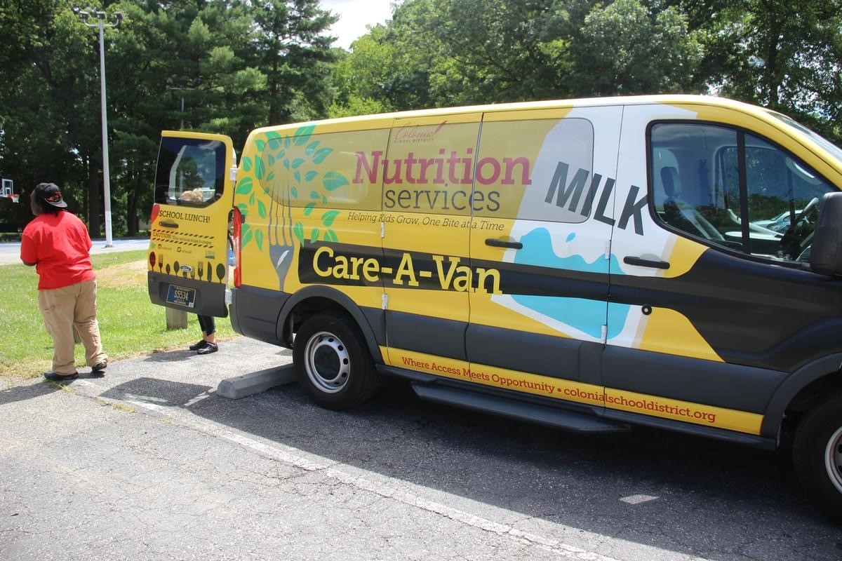
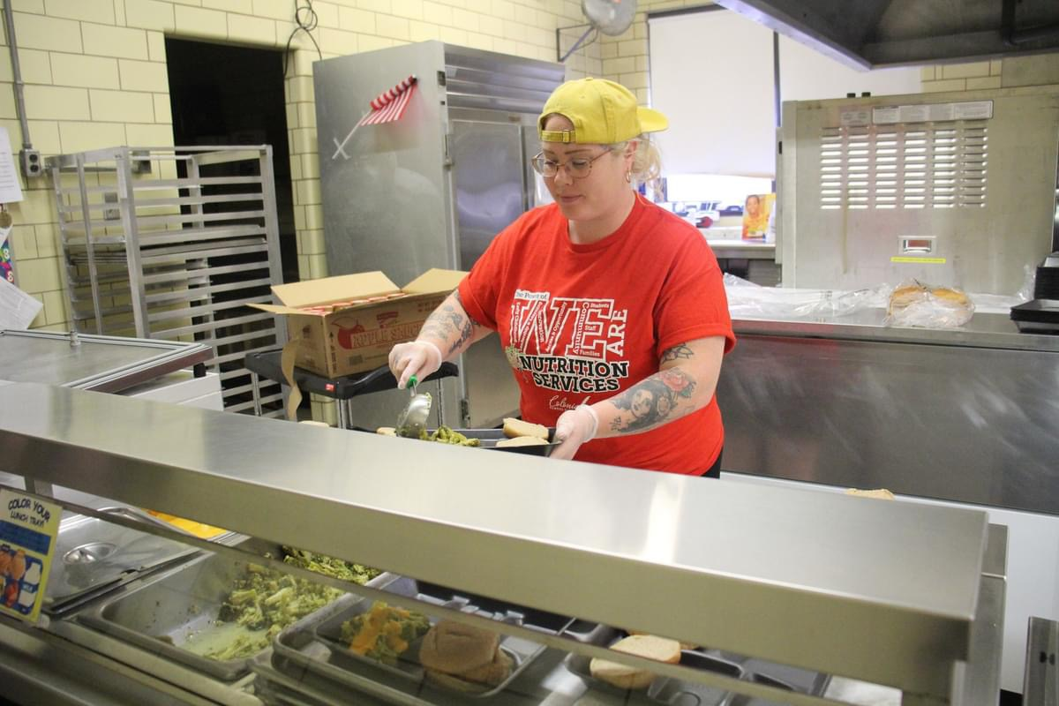
2024 Summer Highlights
Notes:
Theses pictures highlight Colonial School District, the top two pictures show fresh vegetables prepared for meals and an engaging nutrition activity where children learned about healthy foods and even got to taste them!
The bottom left picture shows Colonial School District’s Care-A-Van, delivering meals to the community, while the bottom right shows a staff member preparing and serving meals.

Slide 8
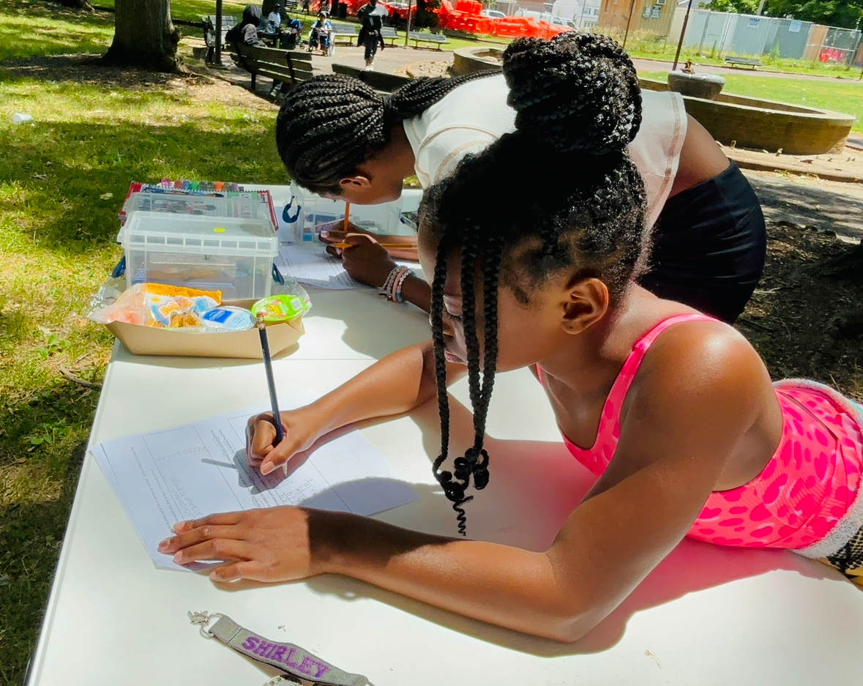
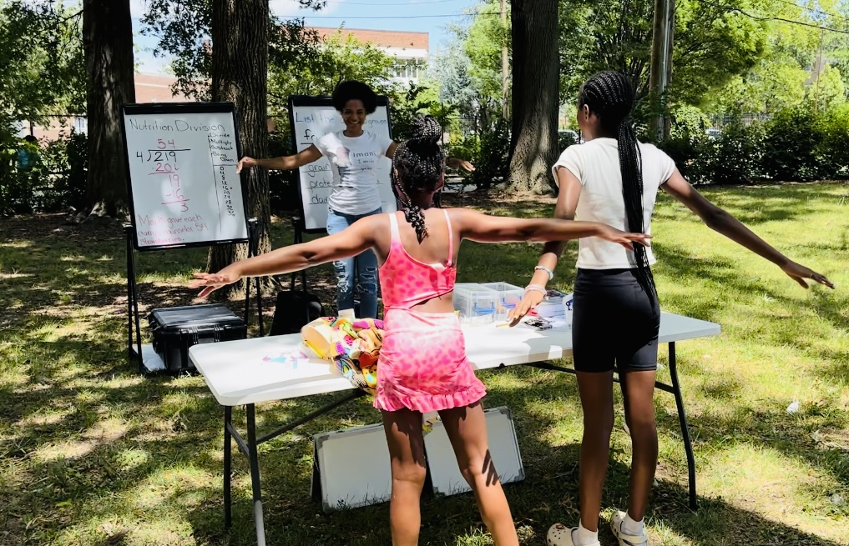
2024 Summer Highlights
Notes:
Pictures from the City of Wilmington! The children enjoyed a nutritious meal and engaged in fun nutrition-related activities.

Slide 9
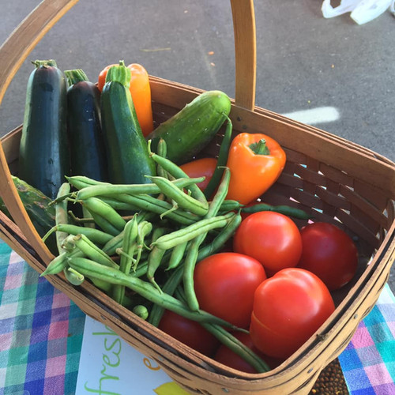
Farm to Summer
Notes:
Farm to Summer benefits everyone, and there are numerous benefits to “bringing the farm” to summer sites:
Sponsors can increase participation by improving the quality and appeal of meals and keeping kids engaged through fun, hands-on activities;
Schools can get started with efforts to source locally during the summer months, testing out recipes using local foods, and creating menus that kids will love;
Food service operators that already source locally during the school year can build upon existing programming and contribute to a continuous, year-round, farm-to-school program;
Regional producers benefit from a reliable outlet for their products during the summer months; and
Kids and teens access fresh, nutritious meals and experiential learning activities at meal sites, staying nourished and active while school is out.

Slide 10
Challenges
Participation
Transportation to sites
Meal site safety
Weather
Menus
Supply chain
Notes:
Over the years, SFSP Sponsors have faced several challenges including:
Getting consistent participation. Participation is key to having a successful SFSP program;
Some children do not have transportation to get to feeding sites to participate in the SFSP program;
Meal site safety presents a challenge for several locations, along with food safety, and safety for the children;
Weather will always be a challenge with high heat index days and rain;
Menus are a challenge with consistent food quality, quantity, and maintaining temperatures; and
Supply chain issues.

Slide 11
2025 Opportunities
Reaching unserved areas
Using existing data to identify target areas for expansion
Strong partners
Activities
Education
Enrichment
Other Supports
Notes:
However, with challenges, come opportunities. Some opportunities for the 2025 SFSP include:
Reaching unserved areas;
Using existing data to identify target areas for expansion;
Having strong partners;
Activities;
Education;
Enrichment; and
Other supports.

Slide 12
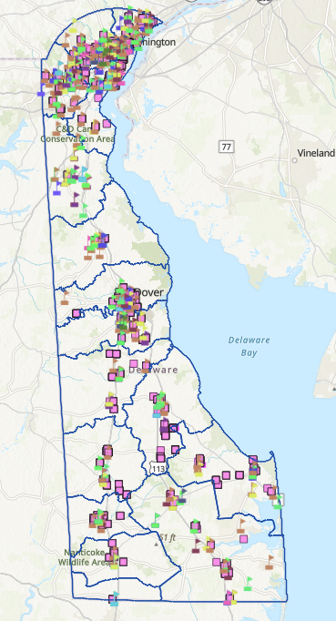
2024 Site Map
Notes:
This map shows 2024 meal sites. Gaps, where can you help?
2024 Meal Site Map: Identifying Gaps & Opportunities
Overview:
Displays meal service locations for SFSP across Delaware. These sites help ensures children have access to nutritious meals during summer.
Gaps in Meal Service:
Rural areas in southern and western areas have limited sites.
Urban outskirts may lack accessible meal locations.
Transportation may be a barrier for families in the communities.
How can you help?:
Host or sponsor new meal sites in high-need areas.
Support mobile meal distribution to reach more children.
Increase outreach to raise awareness about available meal services.
This is an opportunity to expand the program’s impact and ensure all children have access to meals during the summer.Together, we can close the gaps and ensure no child goes hungry this summer!

Slide 13
How Can Families Find Meals?
Call 2-1-1
Call 1-866-3-HUNGRY
Call 1-877-8-HAMBRE
Visit Summer Meals for Kids Site Finder | Food and Nutrition Service

Slide 14
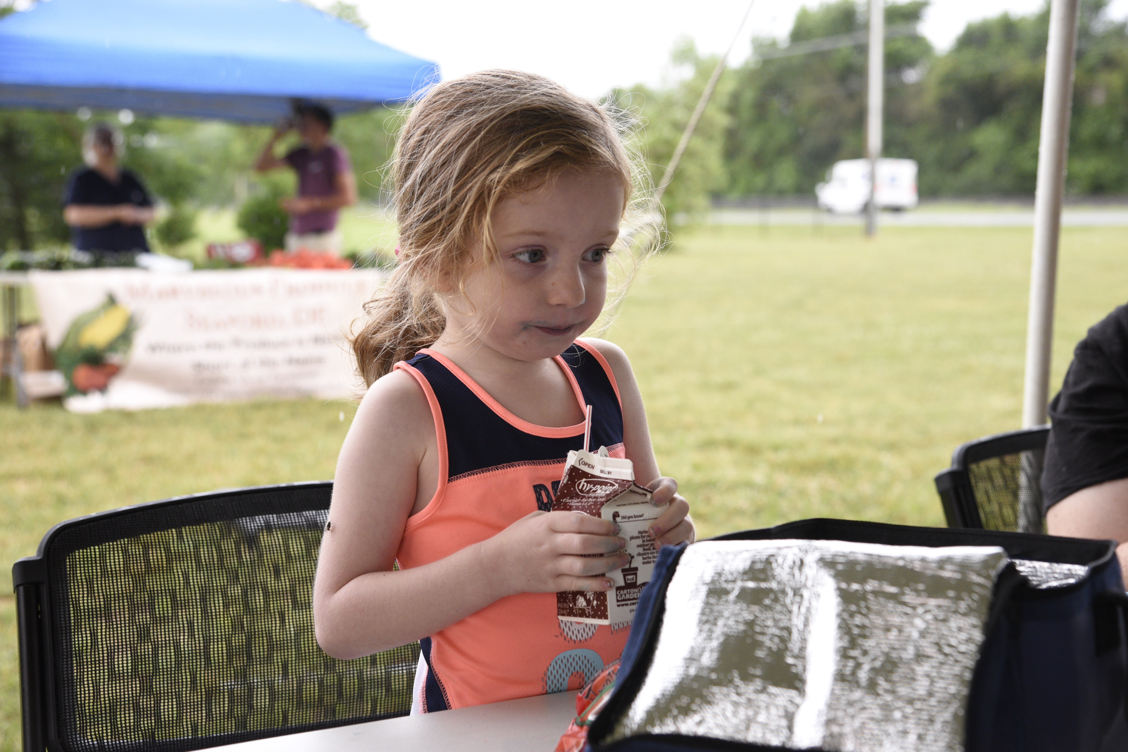
Thank You

