Slide 1



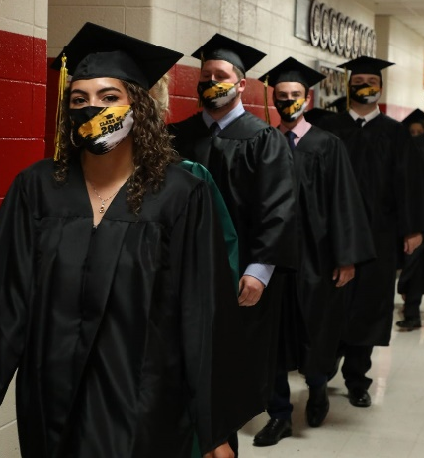


Certificate of Necessity
Overview
May 16, 2024

Slide 2

Today’s Agenda
  Certificate of Necessity Overview
  Jamie Mack, Education Associate, Delaware Department of Education
  Preliminary Land Use Service
  David Edgell, Director, Delaware Office of State Planning Coordination
  DEMA Drawings Review
  Nicole Shuler, Delaware Emergency Management Agency
  Doug Scheer, Delaware Emergency Management Agency
  Question/Answer – Open Discussion

Slide 3
Contact Information
  Jennifer Carlson, Director of Finance, Delaware Department of Education
  Phone: (302) 735-4041
  Email: Jennifer.Carlson@doe.k12.de.us
  Jamie Mack, Education Associate, Delaware Department of Education
  Phone: (302) 857-3364
  Email: jamie.mack@doe.k12.de.us
  David Edgell, Director, Delaware Office of State Planning Coordination
  Phone: (302) 739-3090
  Email: David.Edgell@delaware.gov
  Nicole Shuler-Geer, Planner, Comprehensive School Safety Program
  Delaware Emergency Management Agency
  Phone: (302) 659-2201
  Email: Nicole.Shuler@delaware.gov
  Douglas Scheer, Planner, Comprehensive School Safety Program
  Delaware Emergency Management Agency
  Phone: (302) 659-2254
  Email: Douglas.Scheer@delaware.gov

Slide 4
Objectives
Learn about the:
  Certificate of Necessity (CN) Process
    Timeline
    Requirements
    Construction formula updates
  Preliminary Land Use Service Process
    Timeline
    Process
  DEMA Review Process
    Requirements

Slide 5
Resources
Delaware Code
  29 Del. C. § 69: State Procurement
  29 Del. C. § 75: School Construction Capital Improvements
  14 Del. C. § 20: Standard School Construction
  14 Del. C. § 23: School Building Program
  Voluntary School Assessment (NCCo only)
    9 Del. C. § 2661: NCC VSA Requirement
    14 Del. C. § 103: DOE VSA Authority
    22 Del. C. § 842: Municipal VSA Requirement
    9 Del. C. § 6961: Sussex County VSA
      Requires VSA upon action by Sussex County Council
Notes:
Sussex County provided the ability to enact VSA by action of Sussex County Council.

Slide 6
Resources
Delaware’s Administrative Code (Regulation):
Title 14 - Education
    400 Construction
      401: Major Capital Improvement Programs
      405: Minor Capital Improvement Programs
      415: Voluntary School Assessments
    700 Finance and Personnel
      729: School Custodians
        Revised regulations published as proposed on May 1st.

Slide 7
Resources
Schoology
DOE Finance Resources for Districts and Charter Schools
  State of Delaware School Construction Technical Assistance Manual
  Construction Formula Memo
  Construction State and Local Share Memo
  Certificate of Necessity Applications
  VSA Summary
    Path: https://elde.schoology.com/group/7249939456

Slide 8
Certificate of Necessity
The legal document that allows a requesting district to go to referendum for a Major Capital Project(s)
Sets project scope and cost limits
Requires DOE Approval
Good for 12 months from date of issuance
Approved CNs included in the Department’s Capital Budget Request

Slide 9
CN Timeline
Once need is identified, engage with DOE to begin process
Prior to August 31st districts create Certificate of Necessity (CN) application and secure board approval in a public meeting to apply
August 31: CN Application submitted to DOE
September/October : DOE analyzes submissions for consideration and solicits additional information as needed
October 15th: Capital Budget Request submitted to OMB and CN decisions communicated to districts

Slide 10
CN Timeline (cont.)
November: Budget hearings
January: Governor’s Recommended Budget presented
February - May: Bond Bill Committee hearings
May/June: Markup and legislative action
Bond Bill finalized by June 30
July: If requested/approved, district works with Treasurers Office and OMB to receive funding

Slide 11
Certificate of Necessity Application Items
Completed CN application
School Board meeting minutes with approval
Equity Statement on District Letterhead
Supporting documentation (i.e. building assessments from A/E firm, justification for extraordinary site conditions, etc.)
Enrollment history and projections, by grade to include projection methodology
Detailed cost breakdown
Site approval through PLUS, if applicable

Slide 12
CN Project Priorities
Priority 1: Projects intended to address documented patterns of continued student population growth
Priority 2: Projects addressing serious life, health, safety and/or code violations.
Priority 3: Projects intended to improve facility aesthetics, or building project or program enhancement not related to life, health, and safety code violations.
Additional detail on priority rankings included in Technical Assistance Manual
Notes:
Priority 1 - Projects intended to address documented patterns of continued student population growth

Slide 13
FY 26 Construction Formula
Elementary School is $519.54/SF
Middle School is $554.84/SF
High School is $592.08/SF
Construction formula is reviewed annually
Items not included in Construction Formula
  Land acquisition and associated costs
  Extraordinary site conditions (justified)
Notes:
Over the past several years, there has been significant increases in costs which was adjusted in the increases in per square foot construction rates for school projects in the last several years.
However, the PPI trends of the last year have reflected a leveling of the rates and the last few months have shown a slight decline in the PPI. With that in mind, DOE will hold the construction rates steady at the level established for FY25 CN applications which was a 20% increase over FY24 rates. This provides a stable path forward while also ensuring that we are providing sufficient funding as the rate will remain stable despite decreases in the PPI data over the last several months.

Slide 14
Construction Formula
Facilities included:
  Kindergarten Centers
  Elementary Schools
  Intermediate Schools
  Middle Schools
  High Schools
  100% State funded special needs schools (listed in 29 Del. C. § 7503)
  Square footage is determined in School Construction Technical Assistance Manual, Section 3, School Construction Formula
  Facilities not included:
  Pre-k facilities
  Adult education facilities
  District Offices

Slide 15
Construction Formula (cont.)
State and local cost share
  Calculated annually and includes:
    Construction formula - Generates average student cost
    District Ability Index
    Local share ranges between 20% - 40%
    Districts may apply for 100% locally funded projects
    Escalation will be 5% annually, not compounded, beginning in the second year of funding

Slide 16
Certificate of Necessity
Applications
Certificate of Necessity Applications (available on Schoology)
  Land Purchase
  New Construction
  Renovation
  Funding Worksheet Includes:
  Escalation calculation
  Extraordinary site conditions
  State/local share
  Enrollment history/projections

Slide 17
Questions?
Jamie Mack
Education Associate, Capital Projects
jamie.mack@doe.k12.de.us
302-857-3364

Slide 18
DEMA
HB 49 Requirements and Process

Slide 19
What is The Comprehensive School
Safety Program (CSSP) @ DEMA?
Duties and responsibilities of the Department:
The Department, by and through the Secretary, shall have overall operational responsibility for the implementation of the act. In connection therewith, the Department's duties and responsibilities shall include but not be limited to:
Serving as the lead agency in the development of CSSPs (Comprehensive School Safety Plans) for each school and district;
Assisting schools and districts in conducting critical incident and tabletop exercises;
Adopting, publishing and updating Emergency Preparedness Guidelines;
Reviewing and certifying CSSPs submitted by schools and districts;
(5) In consultation with the Department of Education, adopting such rules and regulations as shall be necessary or desirable to implement the provisions of the act;
(6) Reviewing proposed revisions and updates to CSSPs
* About Doug and Nicole.

Slide 20
House Bill 49
What is House Bill 49:
Learn more about House Bill 49
CSSP works in conjunction with the Office of Management and Budget (OMB) Division of Facilities Management (DFM) to review and approve House Bill 49 requirements for all new school construction, and all major capital renovations exceeding One Million Dollars and post January 1, 2019 Certificates of Necessity. The House Bill requires construction that falls into any of the above listed categories to include the following requirements:
A secured vestibule serving as the primary entrance to screen visitors, equipped with an intercom or voice call box and electronically released doors;
Ballistic resistant glass or other ballistic resistant material in all vestibules, lobby, and office areas used to screen visitors;
Classroom doors that can be locked from the outside using a key or magnetic card locking system. Classroom doors with double-sided locks must comply with State or national fire safety regulations; and
Installation of a panic button or intruder alert system capable of being activated from the school office and a handheld device.

Slide 21
School Approval Process
For schools seeking approval for HB 49 requirements, CSSP approval is required before submitting to DFM.
STEP 1
Department of Education (DOE) Process
Visit the DOE website for procedures to be followed by accessing the School Construction Technical Assistance Manual

Slide 22
School Approval Process (Cont.)
STEP 2
CSSP Review Process
To begin the review process, review the HB 49 checklist for schools.
https://legis.delaware.gov/SessionLaws/Chapter?id=15327
https://delcode.delaware.gov/title14/c023/index.html

Slide 23
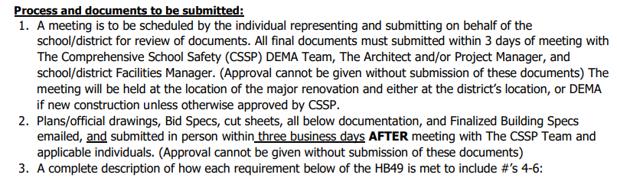
HB 49 Checklist

Slide 24
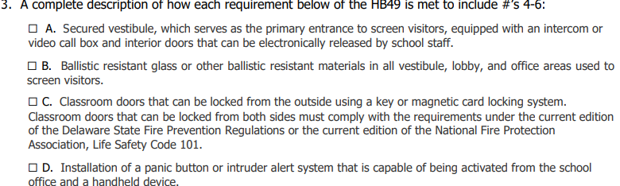
HB 49 Checklist, Cont.

Slide 25
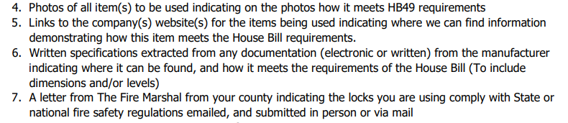
HB 49 Checklist, Cont.

Slide 26
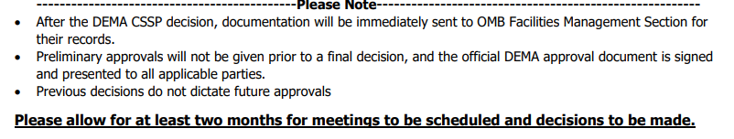
HB 49 Checklist, Cont.

Slide 27
HB 49 Checklist, Cont.
STEP 3
Approval
Once you receive approval, you will receive a copy of the HB 49 Construction Approval Form from the CSSP staff to be included in your submission to DFM.

Slide 28
Other Considerations……
Keeping everyone outside
Areas used to “Screen”
Bullet resistant fiberglass mesh & levels of resistance
Letter from the Fire Marshall must contain name/model of locks
Electronically released doors
May require a letter from Principal and Superintendent no screening will be done outside of designated areas

Slide 29

OSPC
Review and Approval of New Schools
David L. Edgell, AICP
Director
Delaware Office of State Planning Coordination
May 16, 2024

Slide 30
Agenda
Timeframe for Reviews
Site Selection
  Assistance from OSPC (optional)
Preliminary Land Use Service (PLUS) Review of school site
School Site Approval Process (29 Del. C. § 7525)
PLUS Review of school buildings and additions

Slide 31
Timeline
Fall of the year before CN submission
  Site search to identify suitable parcels for new school construction
April
  Latest suggested date for PLUS review of proposed school sites
May
  PLUS Comments received by District
May-June
  Send letter requesting approval to DOE
  Appraisals of selected sites

Slide 32
Timeline
June – August
  Follow up meetings with agencies / service providers (if necessary)
  OSPC prepares School Site Approval Report
    School site approval letter must be issued before CN is submitted
  District finalizes CN request
    Due to DOE by August 31

Slide 33
Site Selection
Must comply with Strategies for State Policies and Spending
  Schools not permitted in Investment Level 4 (rural areas)
  http://stateplanning.delaware.gov/strategies/
Conform to local government comprehensive plans and zoning
Adequate infrastructure
  Transportation
  Sewer & Water
  Gas and other utilities
Location in walkable community setting

Slide 34
Site Selection
Environmental considerations: make sure site is buildable and protect the environment
  Stormwater & drainage
  Wetlands
  Streams
  Natural features
Efficient use of State and District fiscal resources
  Initial cost as well as ongoing operating expenses
  Least expensive land is not always most efficient use of fiscal resources

Slide 35
OSPC Assistance
OSPC planners and GIS staff are available to assist in site search if requested
OSPC will work with the District to identify vacant parcels that meet the above criteria
  We often identify multiple viable parcels to give District options
OSPC will engage State Agencies as needed to address questions and issues with particular sites before and after the PLUS process

Slide 36
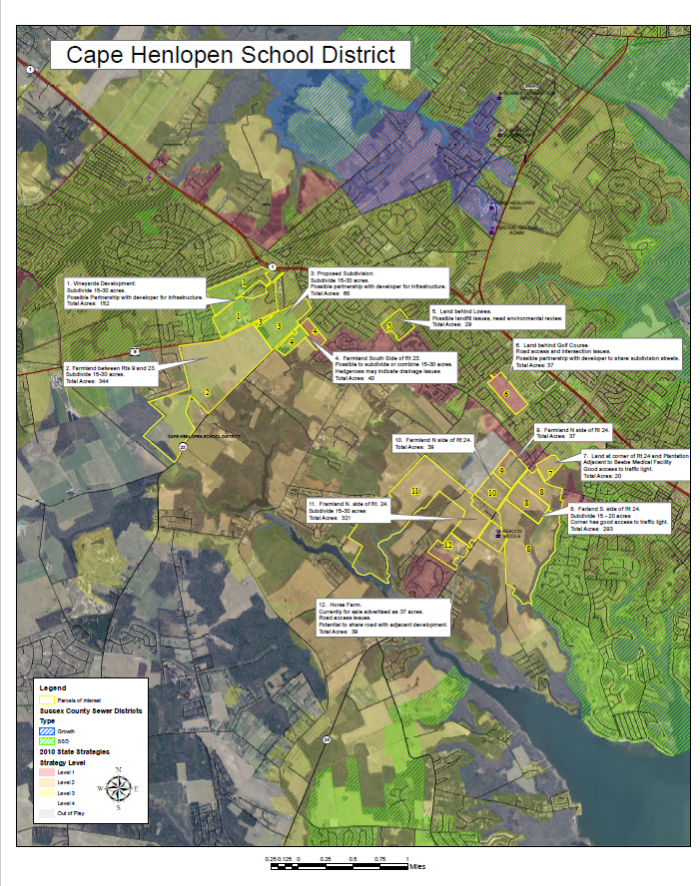
OSPC Assistance

Slide 37
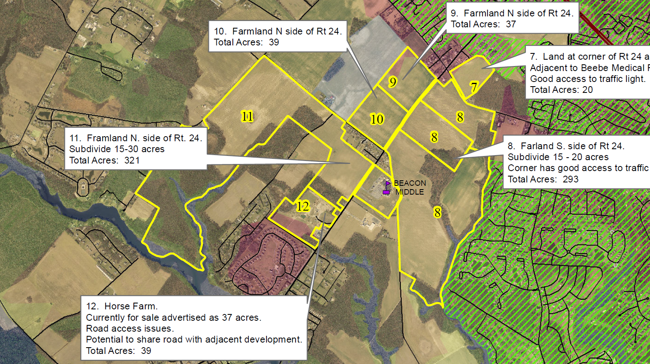
OSPC Assistance

Slide 38
Preliminary Land Use Service (PLUS)
Monthly review of comprehensive plans and development projects by State agencies (OSPC, DelDOT, DTC, DNREC, SHPO, DSHA, Fire Marshal, others)
Review occurs prior to local government planning approval
  Intended to be early “concept plan” review to identify and resolve issues before projects get too far into the approval process.
State funded capital projects are reviewed through PLUS, including:
  New school sites proposed for purchase
  New school buildings
  School additions, regardless of size

Slide 39
PLUS Timeframe
Applications due on the first working day of the month
PLUS meeting occurs on the fourth Wednesday of the same month
  Adjustments made for State holidays
Written comment letter sent no later than 20 working days after the PLUS meeting

Slide 40
PLUS Review of School Sites
District may submit multiple potential school sites for review
Goal is to find out potential issues and benefits of the various sites to select the best one for the District’s project
Agencies provide regulatory comments as well as recommendations
  Permits needed
  Capital projects that may impact school construction
  Environmental constraints
  Design recommendations to accommodate school as well as agency programs

Slide 41
After PLUS Review
Written comments issued within 20 working days from the meeting
  No need to wait to receive written comments to begin addressing issues discussed at the meeting
Select school site to pursue
Send letter requesting school site approval to DOE
  Education Associate responsible for capital program

Slide 42
School Site Approval Report
29 Del. C. § 7525 requires that three agencies approve school site purchases. All three have to agree.
  OSPC – Director of the State Planning Office
  OMB – Director of Office of Management and Budget
  DOE – Secretary of Education

Slide 43
School Site Approval Report
OSPC Principal Planners take the lead in drafting the report, which culminates in a recommendation to the three agencies
A “due diligence” style report which evaluates the benefits of purchasing the site as well as any issues that need to be addressed for a successful school construction project.

Slide 44
School Site Approval Report
Districts should expect to provide:
  Appraisal which conforms to Title 29, § 9505 of Del. C.
  Evaluation of utility availability and cost to extend and connect
    From local government and possibly from District’s consulting engineer
  Final configuration of site to be purchased if subdivision required
  Address all PLUS comments
    Additional study may be necessary in some cases
  Local government letters confirming compliance with comprehensive plan and zoning

Slide 45
School Site Approval
Recommendation
The report will conclude with a recommendation, which will be circulated to the two Directors and the Secretary for their consideration
  Approval – if approved all three sign an approval letter, which is then sent to the District
    This must occur prior to August 31
  Denial – letter with reasons for denial will be sent to the District
    Rare, but it has happened

Slide 46
CN Request to DOE
At least one approved school site must be submitted to DOE along with the CN request

Slide 47
Additional PLUS Reviews
The site plan for the new school must be reviewed by PLUS
  Conceptual layout of new school buildings, transportation access, open space etc.
  This can be combined with the initial PLUS meeting for the school site if the District is certain about the site and far enough along to have a conceptual site layout available
Any school addition, regardless of size

Slide 48

Contact Information
Contact the Circuit Rider Planner for the county your District is located in:
New Castle County
Samantha Bulkilvish, AICP
Principal Planner
Samantha.Bulkilvish@delaware.gov
Kent County
Josh Thomas, AICP
Principal Planner
Josh.Thomas@delaware.gov
Sussex County
Dorothy Morris, AICP
Principal Planner
Dorothy.Morris@delaware.gov
http://stateplanning.delaware.gov/
(302) 739-3090

Slide 49
Thank you – Q&A?
David L. Edgell, AICP
Director
Delaware Office of State Planning Coordination
(302) 739-3090
David.Edgell@delaware.gov
http://stateplanning.delaware.gov/

Slide 50
Goals for Today
Have an understanding of the CN Process
Have an understanding of the PLUS Process
Update stakeholders on new construction formula and applicable uses
Update stakeholders on new CN Applications
Receive feedback for future sessions (good, bad, and what you would like to see)

Slide 51
Thank you!!

