Slide 1
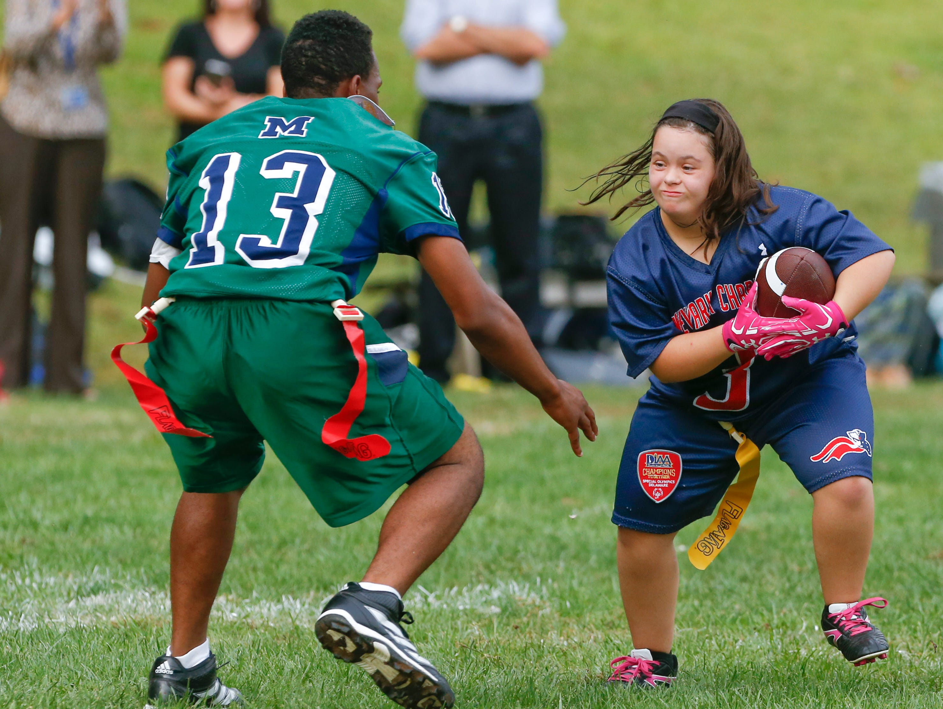
2022 DIAA Unified Flag Football Coaches Rules Clinic

Slide 2
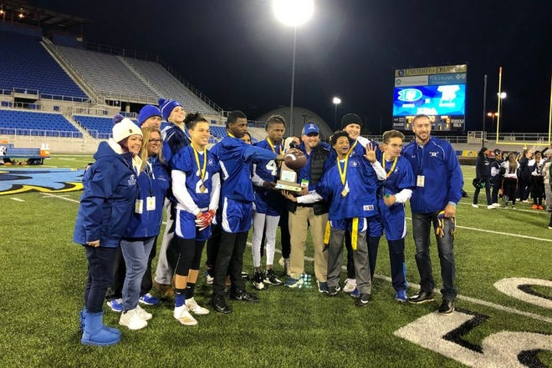
Important Dates
August 15th – Practices can start
September 7th – Season Starts
November 10th – Last Day of Competition
November 13th – Playoff Bracket Released
November 29th – Quarterfinals
December 6th – Semifinals
December 9th or 10th – Championship

Slide 3
Important Reminders
All Unified coaches are required to be certified in adult CPR and complete the NFHS "Concussion in Sports" course.
All Unified coaches must take the NFHS “Coaching Unified Sports®” course online through NFHSlearn.com every two years.
Any school that does not meet the above requirements will not be eligible to receive the $500 stipend provided by Special Olympics Delaware at the end of the season.
Teams are also required to watch “Playing with Integrity” video with their team and complete the QR Code at the end.
https://youtu.be/Lf3Vn02u1OI

Slide 4
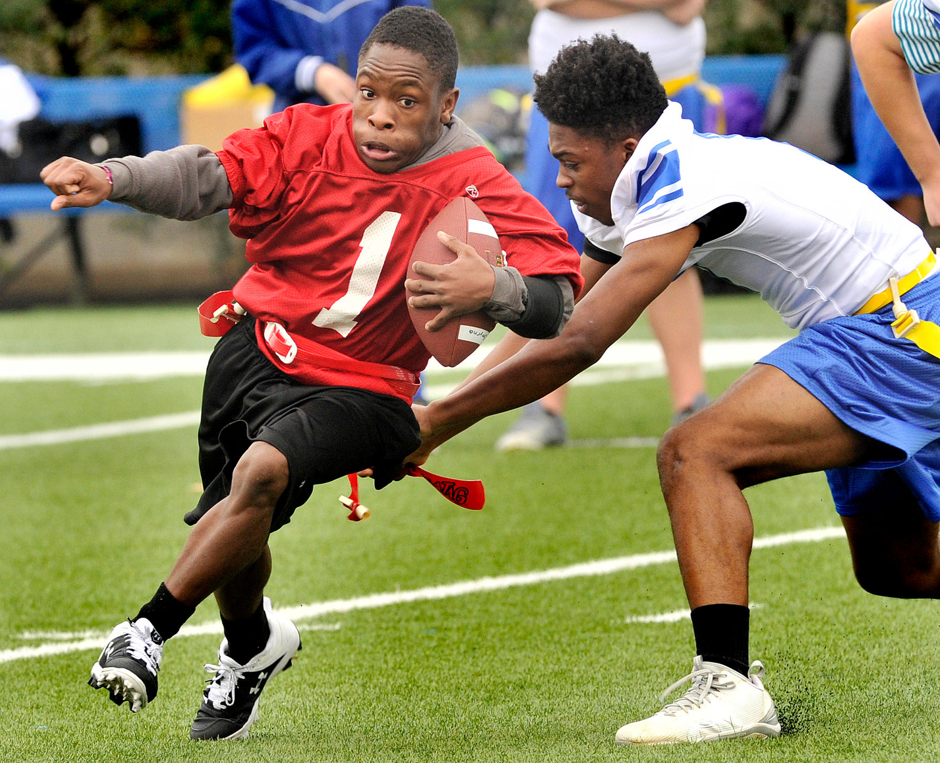
Important Reminders
Once games are scheduled, please make sure your AD has inputted all games into Website4Sports and on arbiter to confirm officials.
DIAA Eligibility Rosters are due on your first day of Unified Flag Football competition.
All exposed undergarments must be solid black, white, or team color.
Shirts with hoods must have hoods tucked in and pants/shorts with pockets are not allowed.
Flags need to be contrasting color from pants/shorts.
If you did not participate last year, make sure you go over the rules to familiarize yourself with last year’s rules changes.

Slide 5
Important Reminders
If your school does not have a DIAA/SODE Unified Sports banner at your field and would like one, please email nate.threatts@sode.org

Slide 6
Unified Sports Cancellation Policy
In the circumstance a game must be cancelled or postponed, the school cancelling/postponing must notify the sports official assigner and Nate Threatts at nate.threatts@sode.org by 11:30AM the day of game. Failure to do so may result in the offending school being charged the cost of officials for the game (Flag Football: $135).
New Castle Football - Rodney Smith - rodney.smith@appo.k12.de.us
Kent Football - Pete Celiberti - heyref@comcast.net
Sussex Football – Jim Feehery - jrfeehery@aol.com

Slide 7
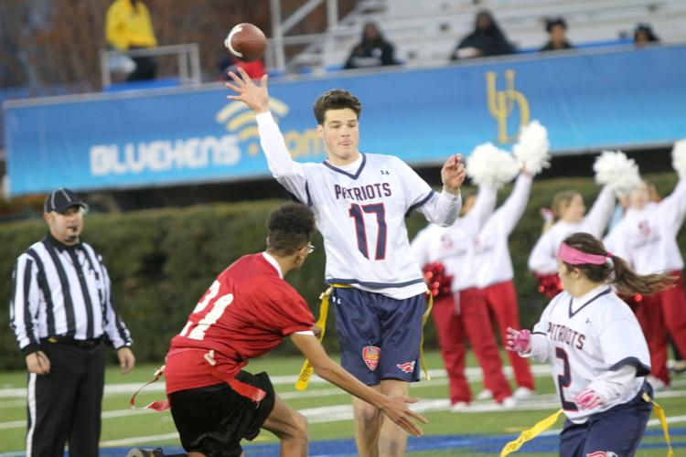
Season Structure Change
Schools are responsible to create their own schedule.
Minimum games: 5
Maximum games: 10
Forfeits will count toward satisfying this requirement.
Teams can play 3 games per week.
3rd game of the week must be played on a weekend.
Last competition date will be on November 10th.
Playoffs begin as soon as November 16th based on number of teams in tournament.

Slide 8
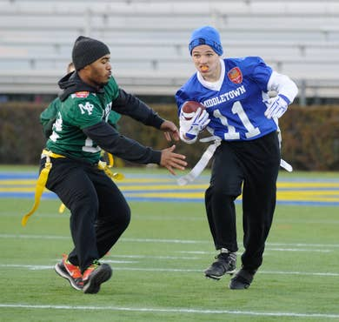
Tournament Structure
Open Tournament with seeding index.
Committee will only count the first 2 games against the same opponent towards a team’s seeding index.
Only those opponents who have played a minimum of four (4) games at the varsity level will be included in a team’s win/loss percentage record and team index. Forfeits will count toward satisfying this requirement.
Seeding Scoring System
2 points for win
1 point for tie
0 points for loss
Bonus points
2 for playing a team with .701 or higher winning percentage
1 for playing a team with .501 - .700 winning percentage
Tie-Breakers (In order)
Overall Record
Head-to-Head Competition
Record Against Common Opponents
If a tie still exists, the Committee will select the order by vote.

Slide 9
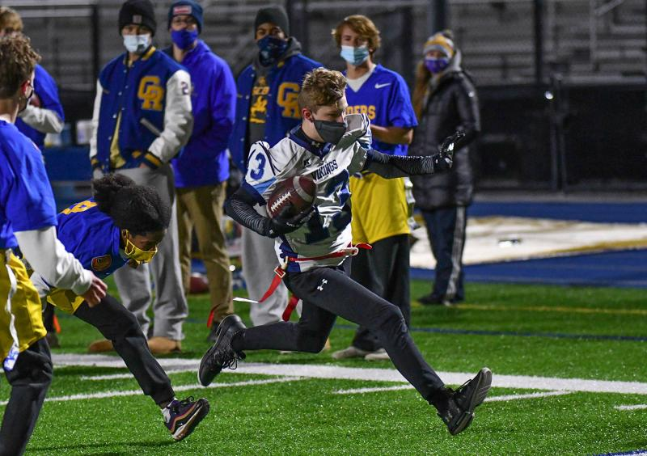
Rules Changes
No roster card exchange this year
Flag guarding will be penalized from the spot of the foul instead of the line of scrimmage.

Slide 10
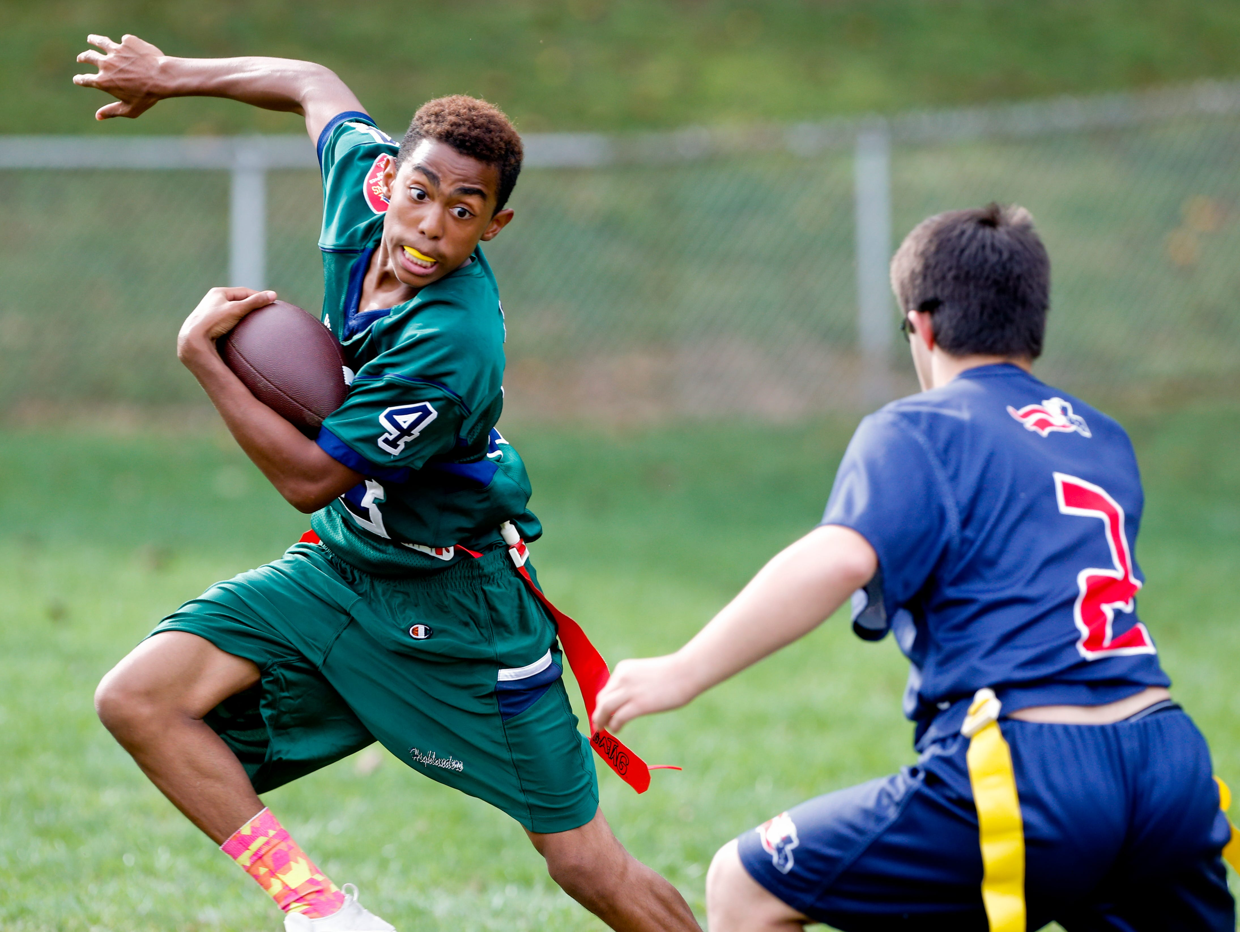
Points of Emphasis
During the game, substitutes, coaches, and team attendants should be located on opposite sidelines from the other team and between the 5‐yard lines.
Work on teaching your players to avoid contact.
Defenders must make an effort not to run through ball carrier
Ball carriers must make an effort to get around established defender
No holding a ball carrier to get their flag
Make sure offensive players’ flags are on their hips before the start of each play.
A Unified Sports team shall not include student-athletes who dominate play, exclude other teammates from contributing to the success of the team, or present a health and safety risk.

Slide 11
Questions?
Please contact Nate Threatts at: nate.threatts@sode.org

